Slide 1




Text Mining HR Appraisal Process Data

Slide 2
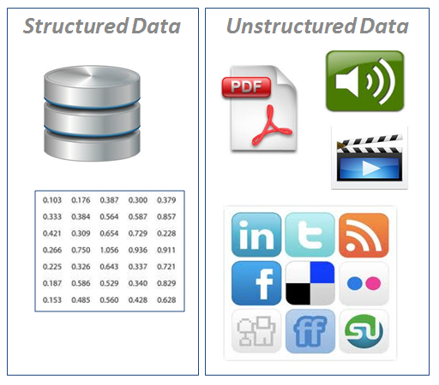
Structured Vs. Unstructured Data

Slide 3
What Is Text Analysis
Text Mining is also known as Text Data Mining (TDM) and Knowledge Discovery in Textual Database (KDT)
It is a process of identifying novel information from a collection of texts (Also known as a ‘Corpus’)
Corpus is a collection of ‘documents’ containing natural language text. Here, documents, generally, are sentences. Each document is represented as a separate line.

Slide 4
Case Study – HR Appraisal Process Feedback
Background
Objective
Available Information
The company XYZ carried out Annual Performance Appraisal process which is a routine HR process.
To understand the employee sentiments and incorporate recommendations in the current performance appraisal process.
Feedback and comments from the employees were stored in a text document.
The employees were asked to give feedback about the overall process and questions used for assessing their performance level.

Slide 5
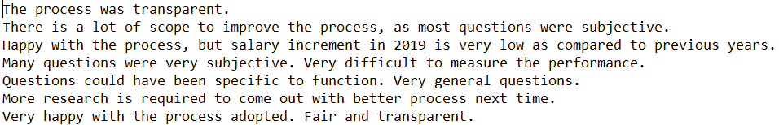
Data Snapshot
Example of data
Text Observations
*
These are the comments received from employees.
Note that, data is not in structured format.

Slide 6
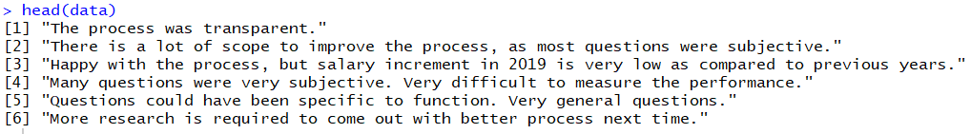
Text Mining In R
#Import the data.
#Import text file with one text record in one row
data<-readLines("HR Appraisal process.txt") head(data)
readLines() reads some or all text lines from a file or connection.
# Output:
Interpretation:
head() prints first 6 text lines from the data with each line as one document / observation.

Slide 7

Text Mining In R
#Convert this data into ‘Corpus’
install.packages("tm") library(tm) corp <- Corpus(VectorSource(data)) class(corp)
Install and load Text Mining (tm) package.
Vector source() interprets each element of the vector as a document.
Corpus() converts and saves data as a corpus.
Interpretation:
Class of the data should be Corpus.
*
In case NLP is not loaded , Before installing tm , please run the following command
install.packages("NLP")
library(NLP)

Slide 8
Text Mining In R
# Inspect Corpus. Here [1:3] displays first 3 textlines.
inspect(corp[1:3])
<<SimpleCorpus>> Metadata: corpus specific: 1, document level (indexed): 0 Content: documents: 3 [1] The process was transparent. [2] There is a lot of scope to improve the process, as most questions were subjective. [3] Happy with the process, but salary increment in 2019 is very low as compared to previous years.
# Display a particular document from corpus.
writeLines(as.character(corp[[3]]))
Happy with the process, but salary increment in 2019 is very low as compared to previous years.
writelines() prints text line of specified number in [[]]. Here it is printing 3rd line.

Slide 9
Text Mining In R
# Clean the Corpus for further analysis
corp <- tm_map(corp, tolower) writeLines(as.character(corp[[3]]))
happy with the process, but salary increment in 2019 is very low as compared to previous years.
corp <- tm_map(corp, removePunctuation) writeLines(as.character(corp[[3]]))
happy with the process but salary increment in 2019 is very low as compared to previous years
corp <- tm_map(corp, removeNumbers) writeLines(as.character(corp[[3]]))
happy with the process but salary increment in is very low as compared to previous years
tm_map() applies transformation functions to a corpus.
tolower converts text to lowercase.
removePunctuation removes punctuation.
removeNumbers removes numbers.

Slide 10
Text Mining In R
# Clean the Corpus for further analysis
corp <- tm_map(corp, removeWords, stopwords("english")) writeLines(as.character(corp[[3]]))
happy process salary increment low compared previous years
corp <- tm_map(corp, removeWords, "process") writeLines(as.character(corp[[3]]))
happy salary increment low compared previous years
removeWords, stopwords("english") remove stop words like: i, me, our and, the, is, etc. There are more than 100 in-built English Stopwords in R. Use stopwords("english") to view the list of these stopwords.
If you wish to remove specific words from the corpus, use tm_map(corp, removeWords, "word"). Here “process” word is removed.

Slide 11
Text Mining In R
# Convert to term-document matrix format
tdm <- TermDocumentMatrix(corp) findFreqTerms(tdm)
# Find terms with frequency of at least 5 and find words having high association with ‘difficult’, ‘questions’
findFreqTerms(tdm,5) findAssocs(tdm, 'difficult', 0.60 ) findAssocs(tdm, 'questions', 0.60 )
TermDocumentMatrix() finds frequent terms in a document-term or term-document matrix. Default minimum frequency is 1 and maximum is infinite. DocumentTermMatrix() and TermDocumentMatrix() gives the same output.
findFreqTerms() gives words with minimum specified frequency . findFreqTerms(tdm,5) gives words having minimum frequency 5.
findAssocs() gives words with specified minimum correlations with the given word. findAssocs(tdm, 'difficult', 0.60 ) gives words with at least 0.6 correlation with word ‘difficult’.

Slide 12
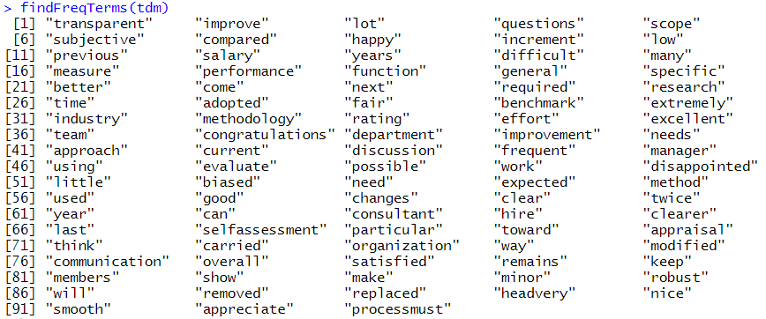
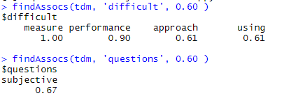
Text Mining In R
# Output:
Interpretation:
questions, subjective, happy, difficult, measure, performance, fair, work are appearing more than 5 times.
Word ‘difficult’ is having high correlation with measure, performance.

Slide 13
Word Cloud In R
Word cloud, as the name suggests, is an image showing compilation of words, in which, size of words indicates its frequency or importance.
# Install and load package “wordcloud”
install.packages("wordcloud") library(wordcloud)
# Convert tdm object to a matrix
m <- as.matrix(tdm) m

Slide 14
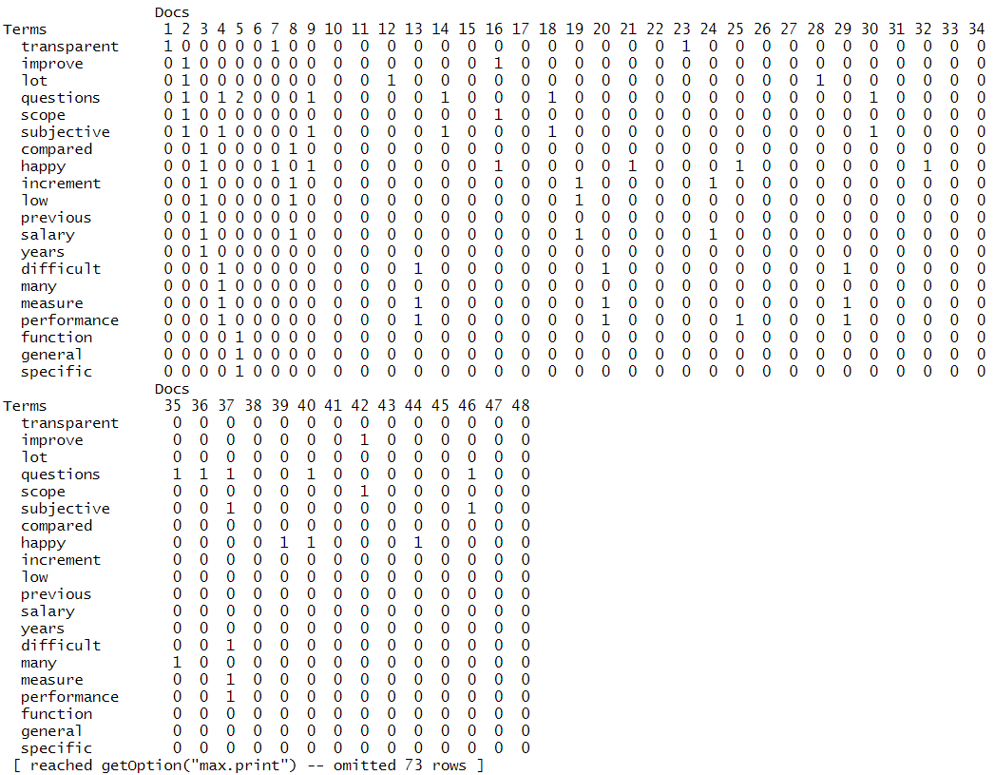
Word Cloud In R
# Output :
Interpretation:
There are 48 docs (text lines).
Example of how to read this output table: Term ‘transparent’ is appearing once in docs 1,7,23 and so on.,

Slide 15
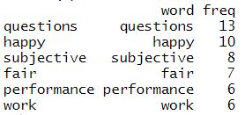
Word Cloud In R
# Calculate total frequency of words & creating a data frame of it
v <- sort(rowSums(m), decreasing=TRUE) myNames <- names(v) d <- data.frame(word=myNames, freq=v) head(d)
# Create color palette
pal2 <- brewer.pal(8,"Dark2")
brewer.pal () was developed by Cynthia Brewer. It makes the color palettes from Color Brewer available as R palettes.
Arguments:
Number of colors included in the palette: 8
Palette Name: 'Dark 2‘
Check out different palettes at http://colorbrewer2.org/

Slide 16
Word Cloud In R
# Get Word Cloud
wordcloud(d$word, d$freq, random.order = FALSE , min.freq = 1,colors=pal2)
First and second argument in wordcloud() are the words (d$word) and the frequency (d$freq) respectively.
random.order=FALSE plots words in decreasing frequency. By default, plot words in random order.
min.freq = words with frequency below min.freq will not be plotted.
colors = color words from least to most frequent with specified color palette.

Slide 17
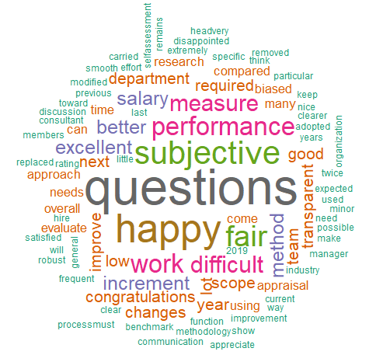
Word Cloud In R
# Output :
Interpretation:
Word questions has largest size, indicating most frequent word followed by happy and subjective and so on..

Slide 18
Text Mining Using ggplot2
Plotting frequent terms as a bar plot
term.freq <- rowSums(m) term.freq <- subset(term.freq, term.freq >= 5)
# Transform as a dataframe
df <- data.frame(term = names(term.freq), freq = term.freq)
# Horizontal bar plot
install.packages("ggplot2") library(ggplot2) ggplot(df, aes(x = term, y = freq))+ geom_bar(stat = "identity") + xlab("Terms") + ylab("Count") + coord_flip()

Slide 19
Text Mining Using ggplot2
# Output :
Interpretation:
Graph shows the frequency of the words appearing at least 5 times on a horizontal bar graph. questions is the most frequent word with frequency more than 10.

Slide 20
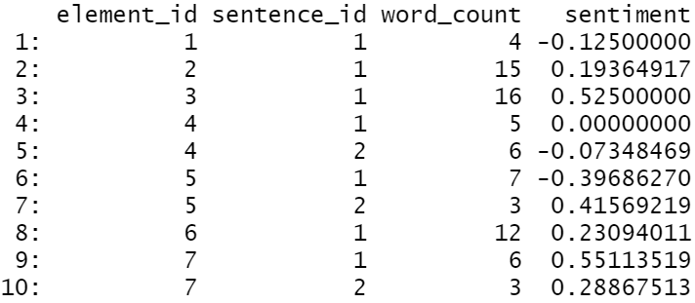
Sentiment Analysis Using "sentimentr"
# Install and Load package “sentimentr”
install.packages("sentimentr") library(sentimentr)
# Calculate Sentiment Score
sentiment() calculates the sentiment values of each sentence in the data.
data<-readLines("HR Appraisal process.txt") sentiment(data)
# Output
element_id is the id number of the original vector passed to sentiment
sentence_id is the id number of the sentences within each element_id
word_count is the count of words in each sentence
sentiment is the sentiment/polarity score of each sentence

Slide 21
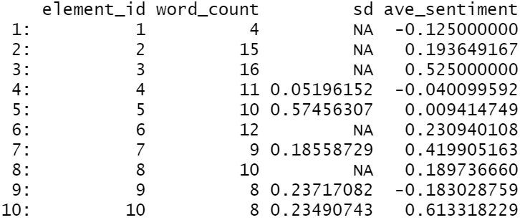
Sentiment Analysis Using "sentimentr"
# Aggregate sentiment scores”
You can also calculate the sentiment scores by aggregating it with respect to different elements. The default value is by=”NULL”, which aggregates the sentiment scores with respect to each line
# Calculate Avg Sentiment Score
sentiment_by(data)
Sentiment_by() calculates the aggregate sentiment values
# Output
sd gives the standard deviation of the sentiment score of the sentences in the review
ave_sentiment gives the average sentiment score of the sentences in the review
*
Note : Sentiment Categories can be derived using Sentiment Scores

Slide 22
Sentiment Analysis Using "syuzhet"
# Install and Load package “syuzhet”
install.packages("syuzhet") library(syuzhet)
# Calculate Sentiment Values
get_sentiment() calculates sentiment of each word or sentence. First argument is a character vector (or sentences or words) and second argument is for method (Which lexicon to be used). The function uses method="syuzhet" by default.
We have passed data object as it is to the function. This ensures feedback with more than one sentences is not split and considered entirely. However, it is a better practice to 'tokenise' data. Sentences separated by full stops are split.
get_sentiment(data)
# Output

Slide 23
Sentiment Analysis Using "syuzhet"
# Display emotions and valence from NRC dictionary
nrcsentiment <- get_nrc_sentiment(data) head(nrcsentiment)
get_nrc_sentiment() calls the NRC sentiment dictionary to calculate the presence of eight different emotions (anger, fear, anticipation, trust, surprise, sadness, joy, and disgust)and two sentiments (positive and negative).
It returns a data frame in which each row represents a sentence from the original file. The columns include one for each emotion type as well as the positive or negative sentiment valence.

Slide 24
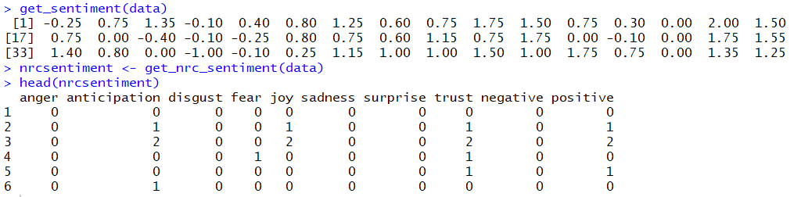
Sentiment Analysis Using "syuzhet"
# Output :
Interpretation:
Negative score indicates ,negative sentiments.
Example of how to read output table : second sentence is having joyful sentiments. 4th sentence has fear sentiment.

Slide 25
THANK YOU!

